Slide 1
introduction
Choosing the optimal hospital location is a crucial policy decision for government and health policymakers.
The priority in healthcare is to provide all patients with the right place and exemplary service while ensuring fairness.
The optimal hospital location is vital for the effectiveness, quality, and equity of health services.
The choice of hospital location is a strategic decision that should be sustainable and capable of eliminating future problems.

Slide 2
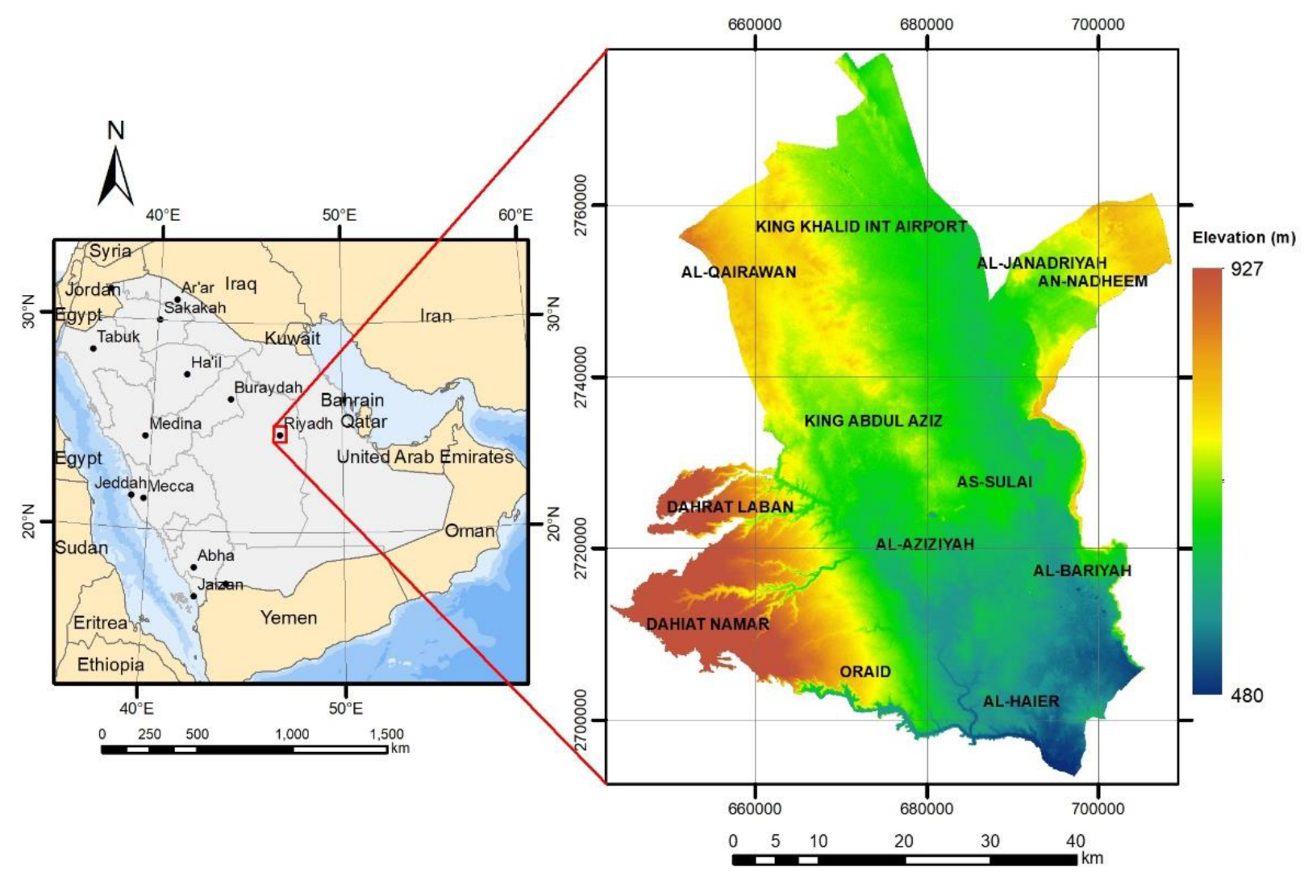
Study area
The study will be conducted in Riyadh city, Saudi Arabia.
Riyadh is the capital and largest city of Saudi Arabia with 15 municipalities.
Riyadh is located between latitude 24.4N-24.9N and longitude 46.4E-46.9E.
The city is situated at an altitude of around 600 meters above Mean Sea Level.
Riyadh has an area of roughly 3,115 km².[1]
Figure 1. Location of Riyadh City, Kingdom of Saudi Arabia.[2]

Slide 3
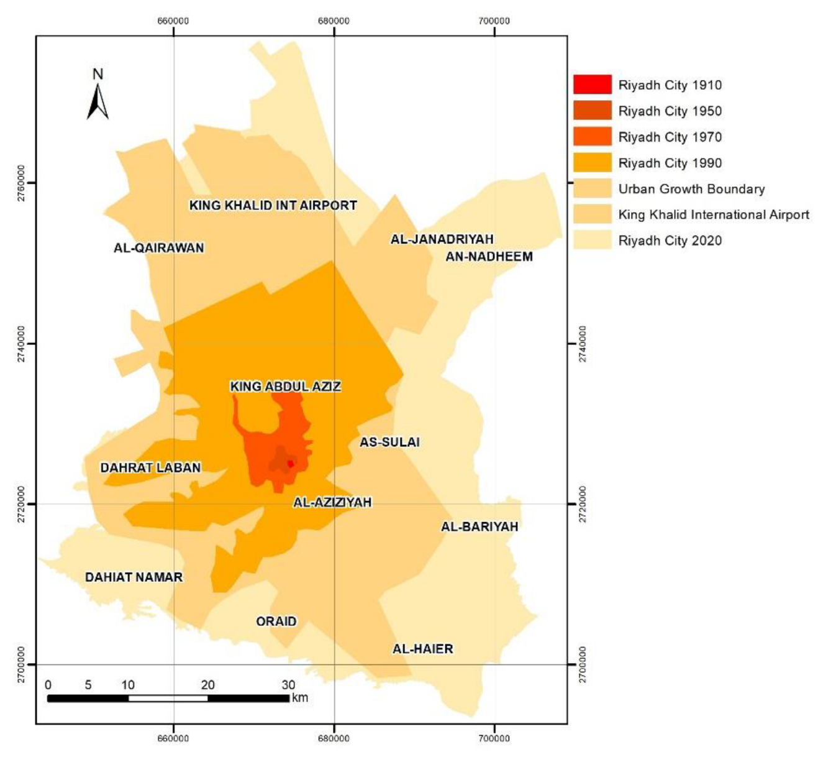
The population of Riyadh exceeded 7 million people in 2022.
Riyadh City has experienced rapid population and a real growth since 1900 with an annual rate of growth of more than 8%.see (figure 2)
The population growth of Riyadh City over the last 5 years was 1.8 million (from 5.2 to 7 million) .[3]
As the population grows and the city of Riyadh expands, there will be a need for more hospitals.
Figure 2. Riyadh City and the urban growth boundaries (1910, 1950, 1970,and 1990).[2]

Slide 4
Problem Statement
The average number of hospital beds/1,000 population for 169 country around the world is 3.1 beds/1,000 population [4]
while in Riyadh it was 2.69 [5]
Therefore, Increasing the number of hospitals is necessary.
Riyadh city
4
Figure 3. List of the average number of hospital beds/1,000 population based on 36 countries and
Saudi Arabia’s ranking. [6]

Slide 5
Project objectives
Selecting the optimal locations for establishing new hospitals by:
Determining the selection criteria
Proposing facility location options
Making the final decision
5

Slide 6
Project background
Many countries and institutions pay great attention to Selecting the optimal location for establishing new hospitals (hospital location-allocation).
It is a multi-criteria decision-making (MCDM) problem that involves balancing conflicting criteria.[7]
Site selection involves ranking alternatives based on weighted criteria in a decision-making process.
Integration of MCDM and GIS is necessary for solving the site selection problem.
GIS technology is used to manage and analyze spatial data, while MCDM techniques using AHP are used to assign weights to criteria and evaluate alternatives. [8]
6

Slide 7
Analytic Hierarchy Process (AHP)
The Analytic Hierarchy Process (AHP), introduced by Thomas Saaty (1980), is an effective tool for dealing with complex decision making, and may aid the decision maker to set priorities and make the best decision. By reducing complex decisions to a series of pairwise comparisons, and then synthesizing the results, the AHP helps to capture both subjective and objective aspects of a decision. In addition, the AHP incorporates a useful technique for checking the consistency of the decision maker’s evaluations, thus reducing the bias in the decision-making process [14] [15].
Goal
Criteria1
Criteria2
Criteria3
Alternative1
Alternative2
7

Slide 8
Criteria comparison
Criteria | D. T. Roads | Population | D.F. Schools | D.F. Gas stations | D.F. Hospitals | D.F. Factories
D. T. Roads | 1 | 3 | 1/2 | 1/3 | 1/2 | 1/3
Population | 1/3 | 1 | 1/3 | 1/3 | 1/2 | 1/4
D.F. Schools | 2 | 3 | 1 | 2 | 3 | 2
D.F. Gas stations | 3 | 3 | 1/2 | 1 | 2 | 1/2
D.F. Hospitals | 2 | 2 | 1/3 | 1/2 | 1 | 1/3
D.F. Factories | 3 | 4 | 1/2 | 2 | 3 | 1
Total | 11.33 | 16 | 3.17 | 6.17 | 10 | 4.42

Slide 9
Criteria weight
Geometric mean:
Roads=$1.51$
Population = 2.45
Distance from Schools = 0.49
Distance from Gas stations = 0.78
Distance from Hospitals = 1.28
Distance from Factories = 0.44
Priority:
Roads= 0.22
Population = 0.35
Distance from Schools = 0.07
Distance from Gas stations = 0.11
Distance from Hospitals = 0.18
Distance from Factories = 0.06

Slide 10
Table.5 shows the ranking and classification for each criterion.
Criteria | Description | Classes | Rank
Population | The nearer to densely populated areas, the better | >12000 7800 – 12000 4300 – 7800 1300 – 4300 <1300 | 5 4 3 2 1
Existing hospitals | The further away from the existing hospitals, the better | >6 4.5 - 6 3 - 4.5 1.5 - 3 0 - 1.5 | 5 4 3 2 1
Main roads | The nearer to the main roads, the better | 0 - 0.2 0.2 - 0.4 0.4 - 0.6 0.6 - 0.8 >0.8 | 5 4 3 2 1
Gas petroleum stations | The further away from the existing gas stations, the better | >0.4 0.3 - 0.4 0.2 - 0.3 0.1 - 0.2 0 - 0.1 | 5 4 3 2 1
km
km
km

Slide 11
Table.5 shows the ranking and classification for each criterion.
Criteria | Description | Classes | Rank
Schools | The further away from the existing schools, the better | >1.2 0.9 - 1.2 0.6 - 0.9 0.3 - 0.6 0 - 0.3 | 5 4 3 2 1
Factories | The further away from the existing factories, the better | >6 4.5 - 6 3 - 4.5 1.5 - 3 0 - 1.5 | 5 4 3 2 1
km
km

Slide 12
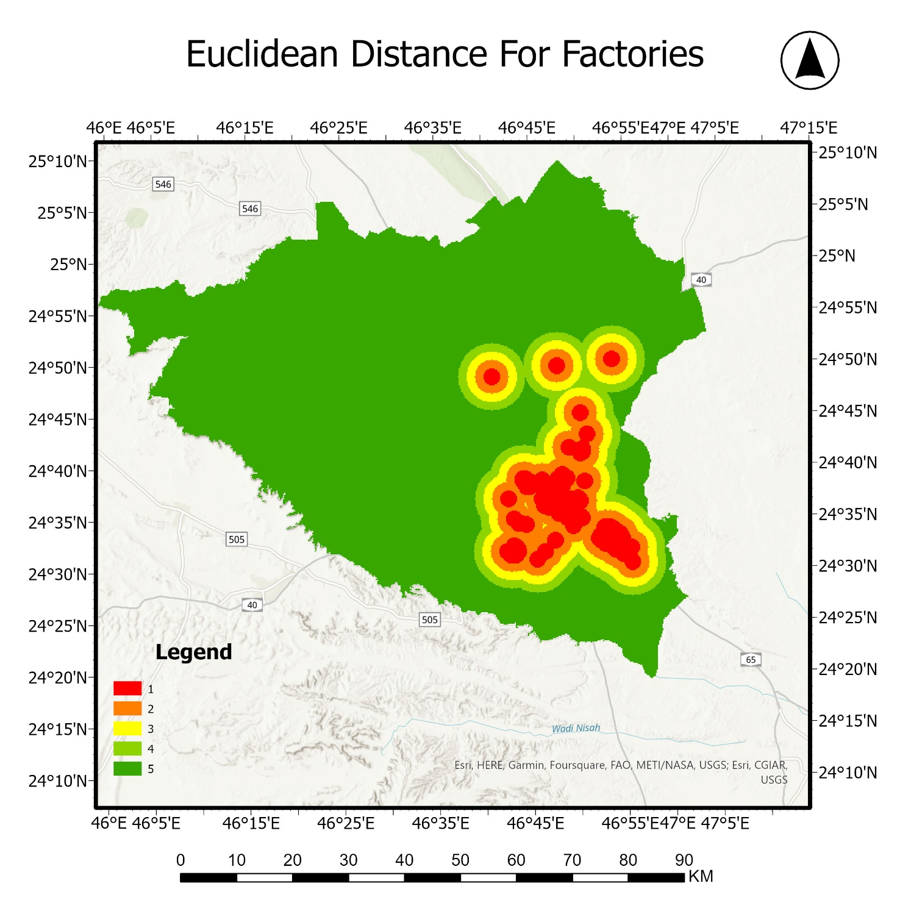
Classes Km | Rank
>6 | 5
4.5 - 6 | 4
3 – 4.5 | 3
1.5 – 3 | 2
0 – 1.5 | 1
Figure 6. Shows the Euclidian distance of factories.
The further away from factories, the better.

Slide 13
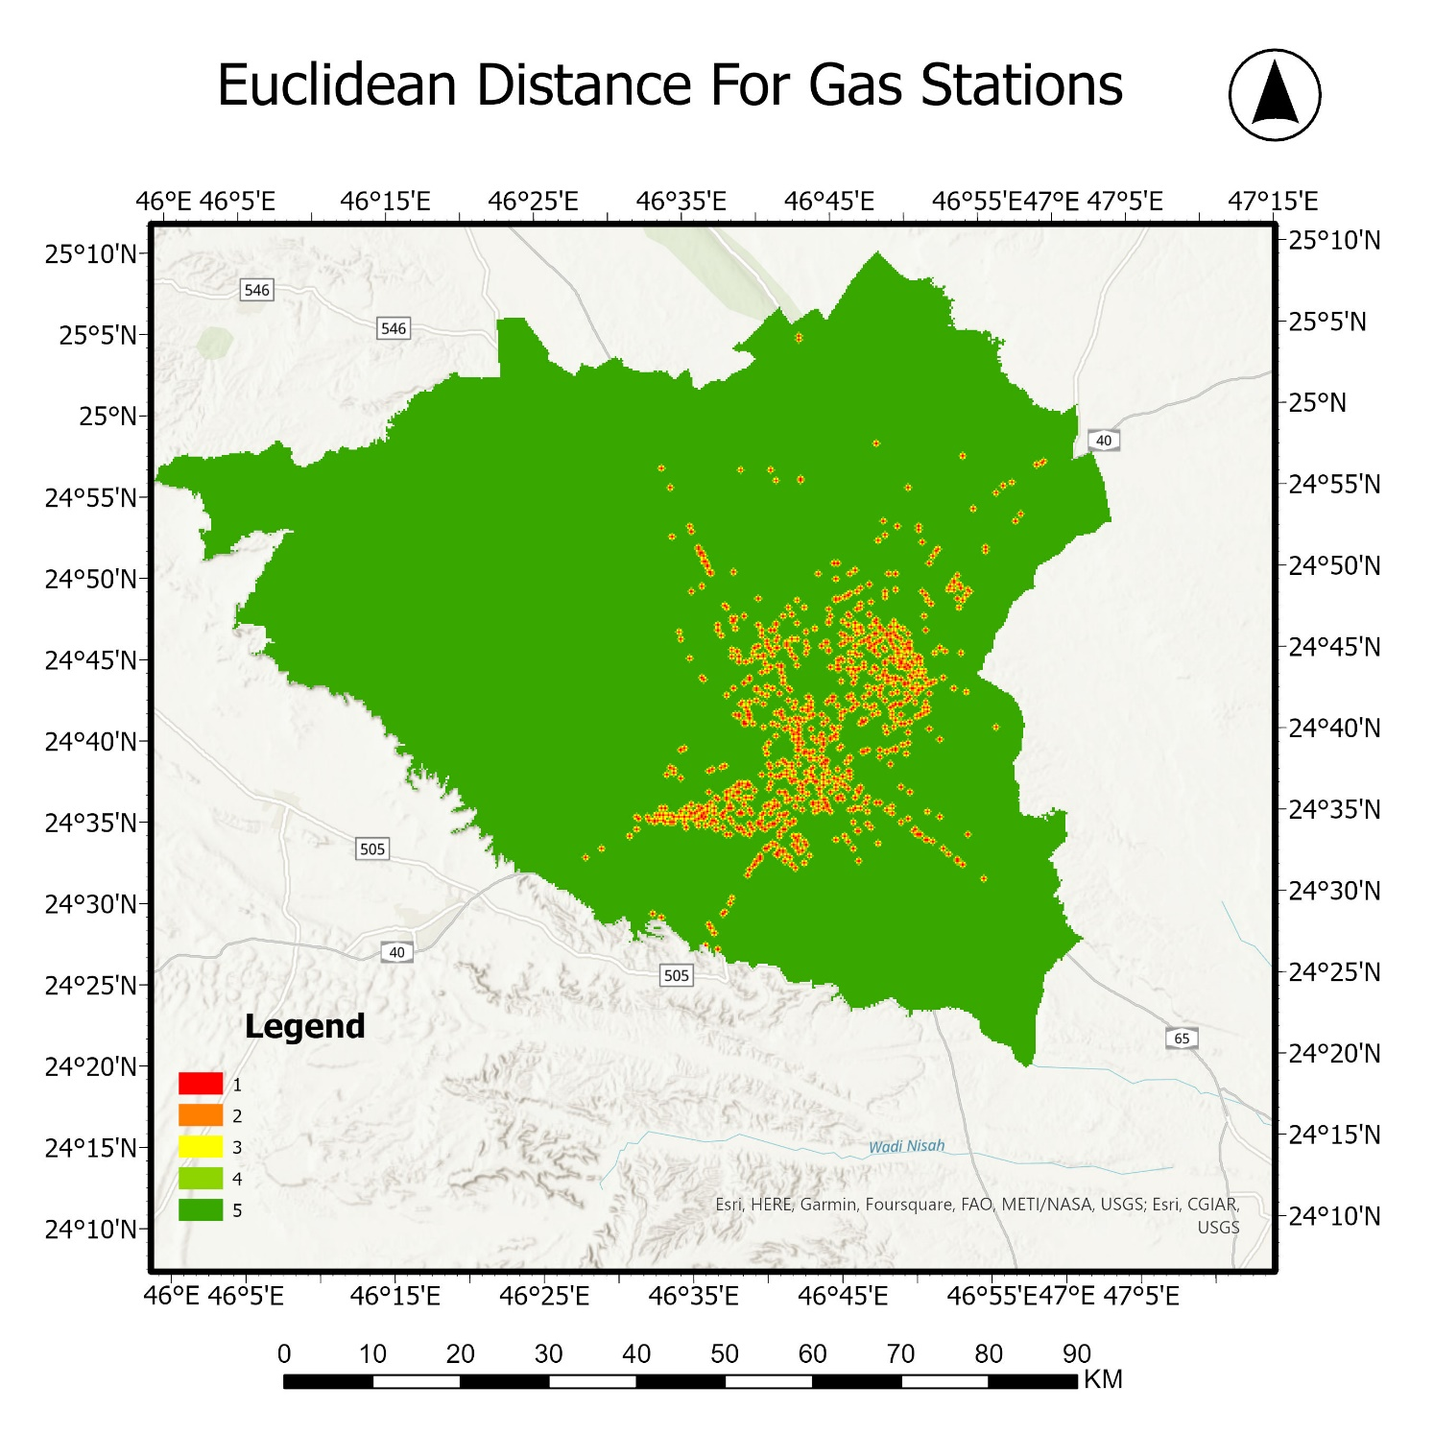
Classes Km | Rank
>0.4 | 5
0.3 - 0.4 | 4
0.2 – 0.3 | 3
0.1 – 0.2 | 2
0 – 0.1 | 1
Figure 7. Shows the Euclidian distance of gas stations.
The further away from gas stations, the better.

Slide 14
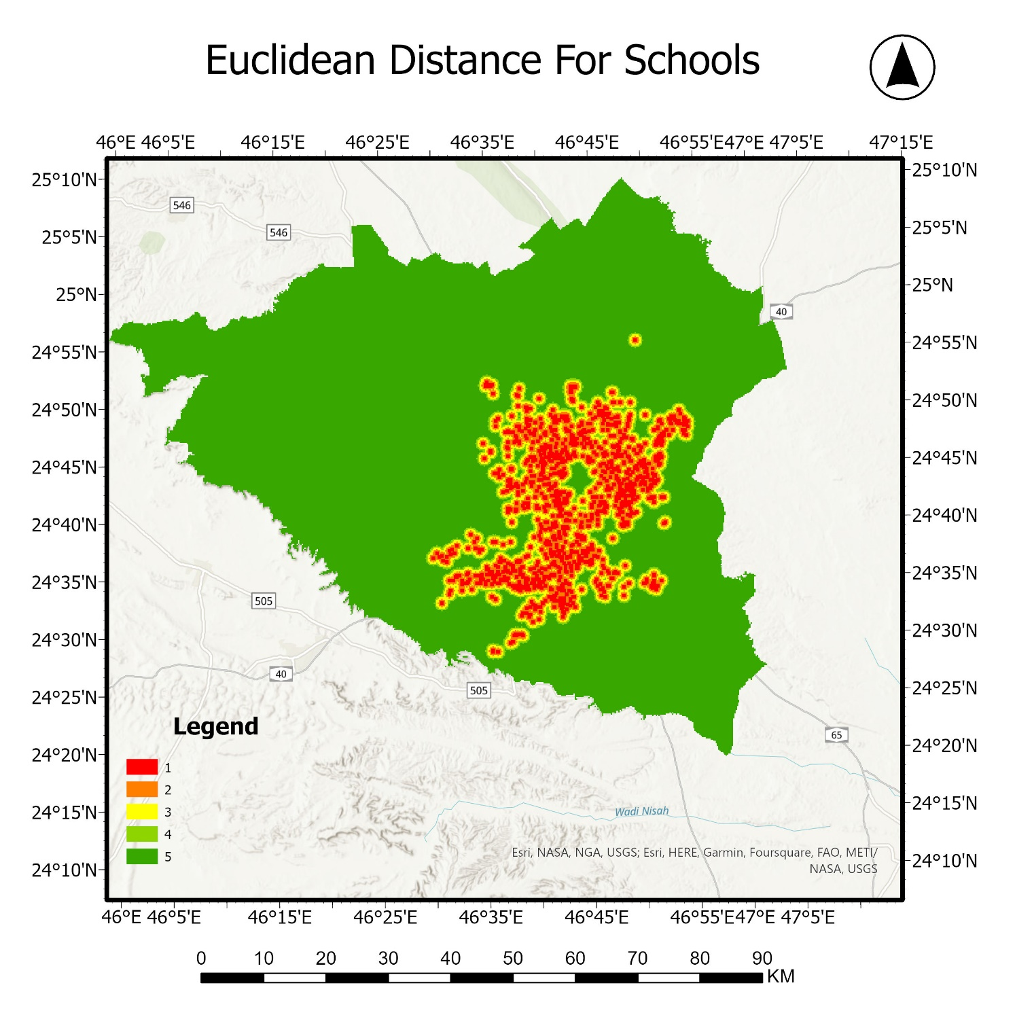
Classes Km | Rank
>1.2 | 5
0.9 – 1.2 | 4
0.6 – 0.9 | 3
0.3 – 0.6 | 2
0 – 0.3 | 1
Figure 8. Shows the Euclidian distance of schools.
The further away from schools, the better.

Slide 15
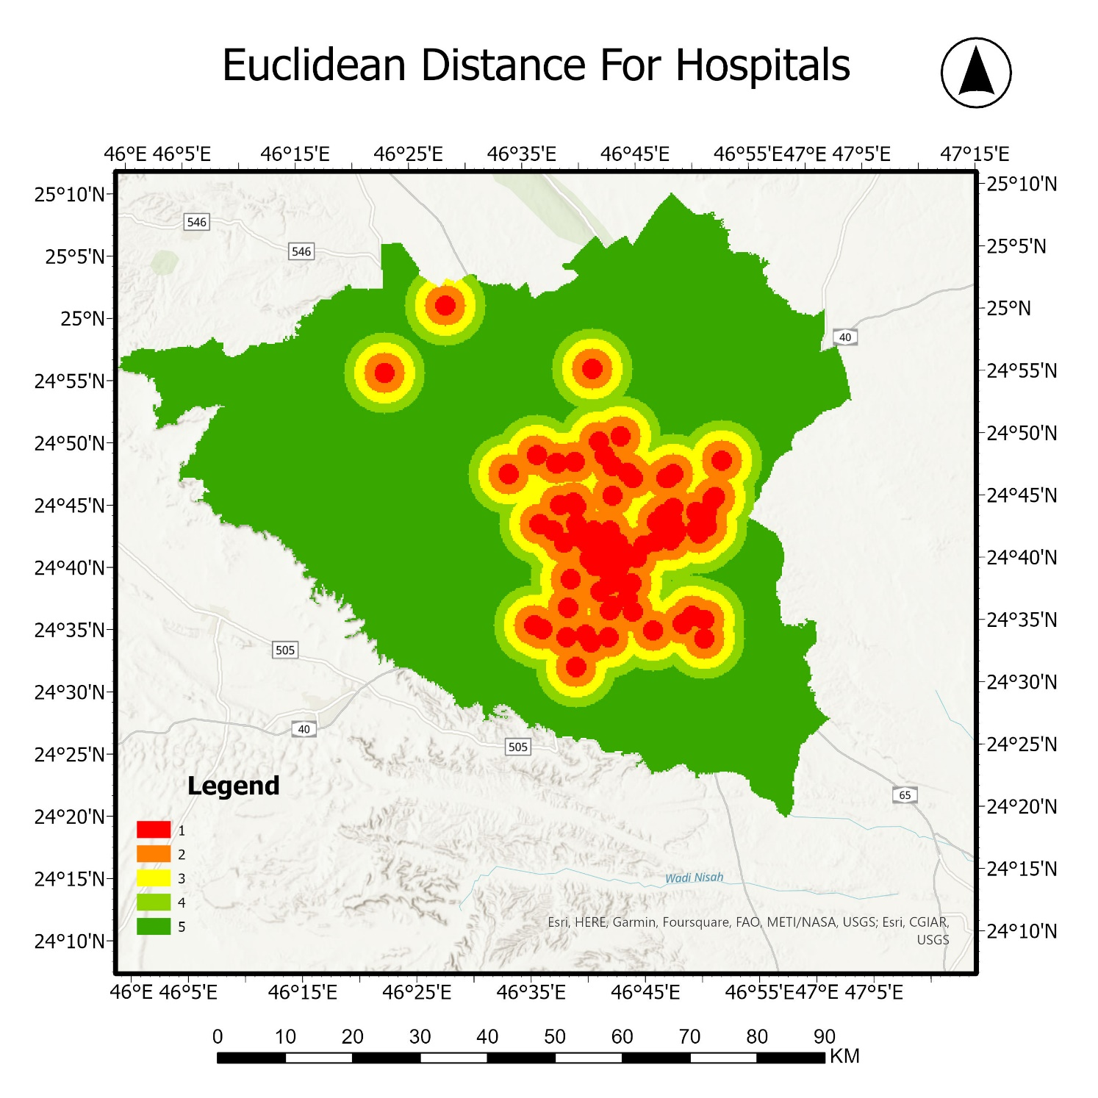
Classes Km | Rank
>6 | 5
4.5 - 6 | 4
3 – 4.5 | 3
1.5 – 3 | 2
0 – 1.5 | 1
Figure 9. Shows the Euclidian distance of hospitals.
The further away from hospitals, the better.

Slide 16
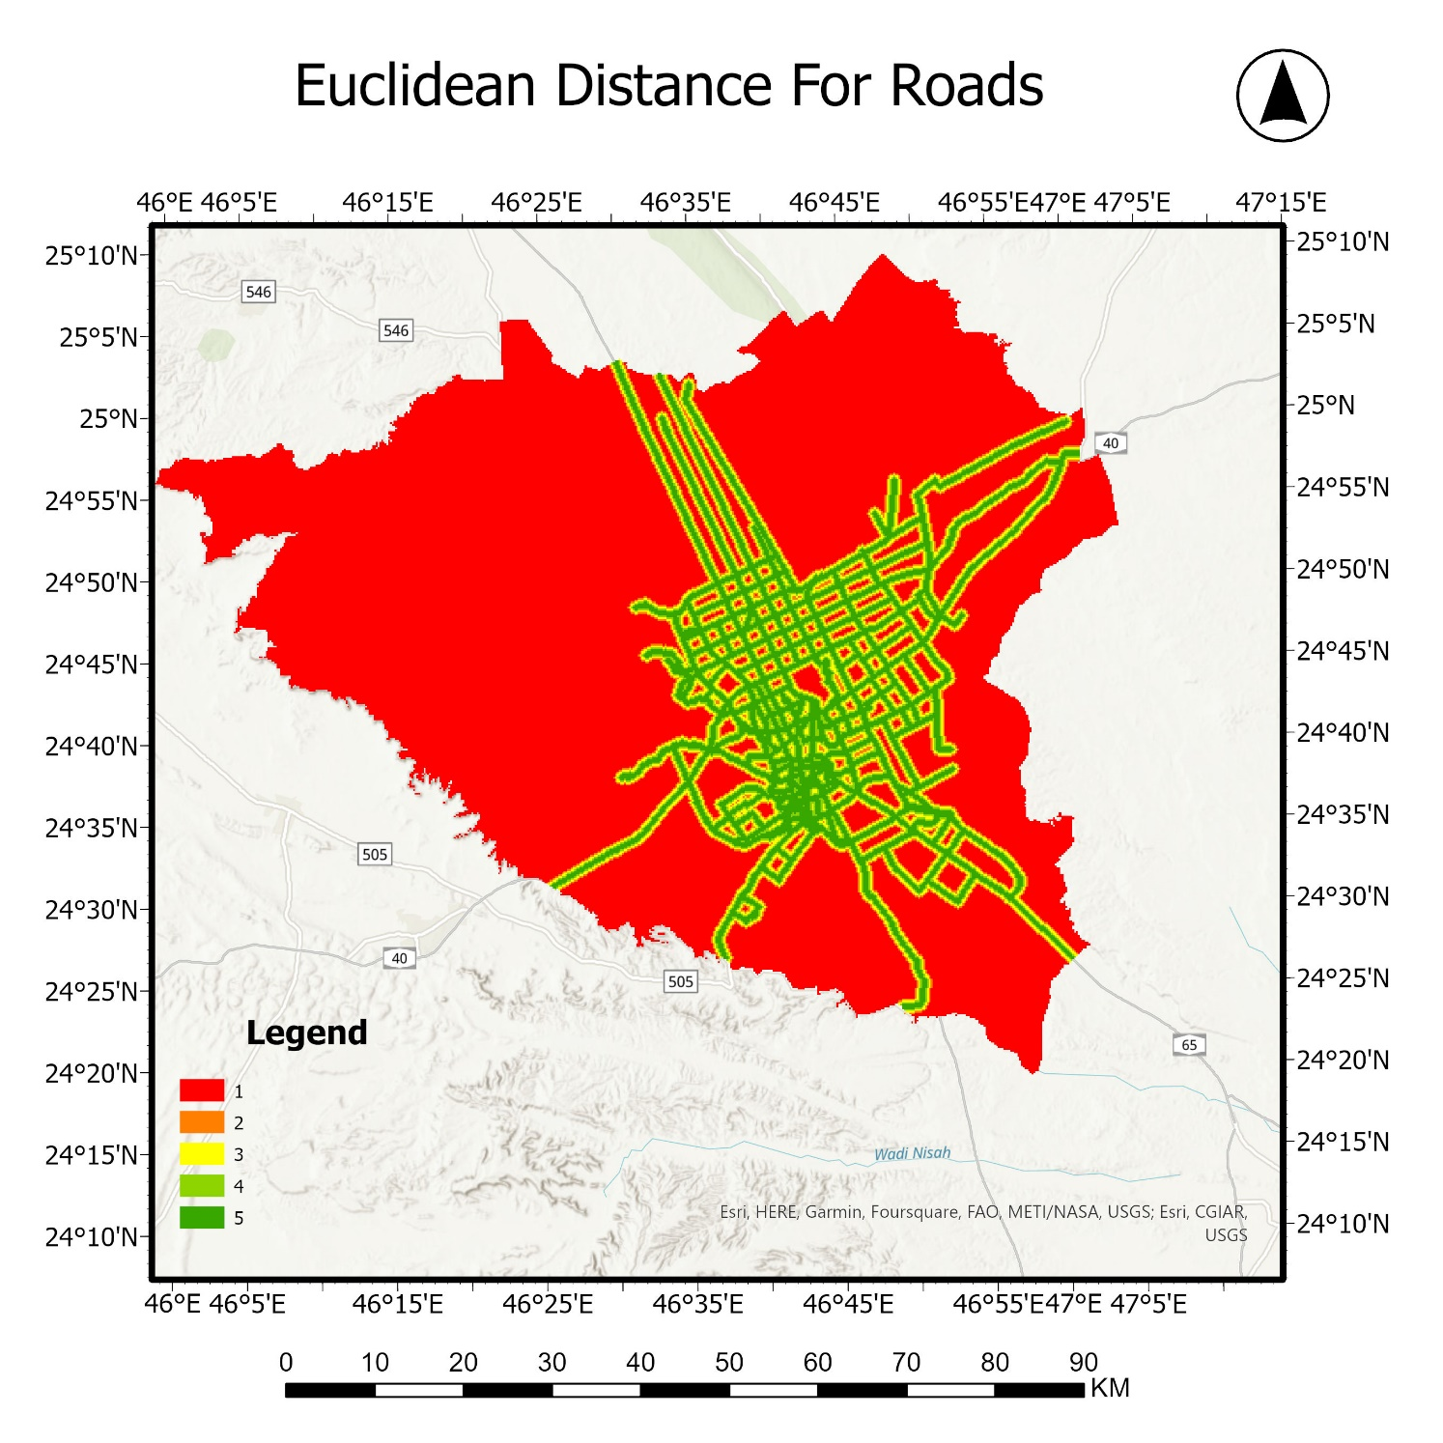
Classes Km | Rank
0 - 0.2 | 5
0.2 – 0.4 | 4
0.4 – 0.6 | 3
0.6 – 0.8 | 2
>0.8 | 1
Figure 10. Shows the Euclidian distance of main roads.
The nearer to the main roads, the better.

Slide 17
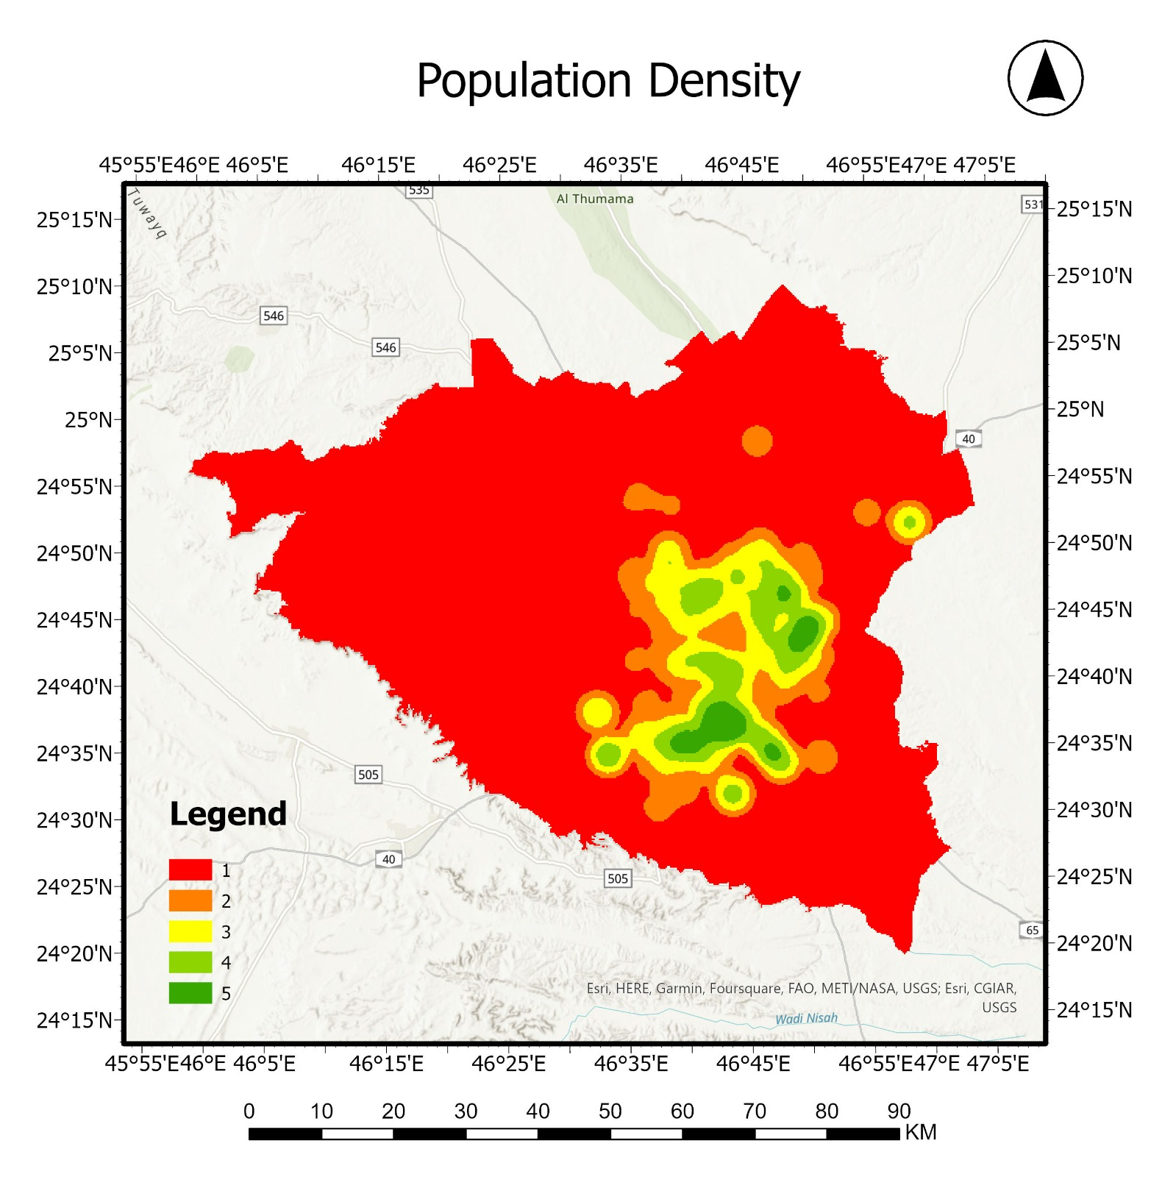
Classes | Rank
>12000 | 5
7800 - 12000 | 4
4300 – 7800 | 3
1300 – 4300 | 2
<=1300 | 1
Figure 11. Shows the population density.
The nearer to densely populated areas, the better.

Slide 18
C1xW1
Population
Schools
C2xW2
Hospitals
C3xW3
Roads
C4xW4
Gas stations
C5xW5
Schools
C6xW6
Factories
Final map
Figure 12. Shows GIS layers model

Slide 19
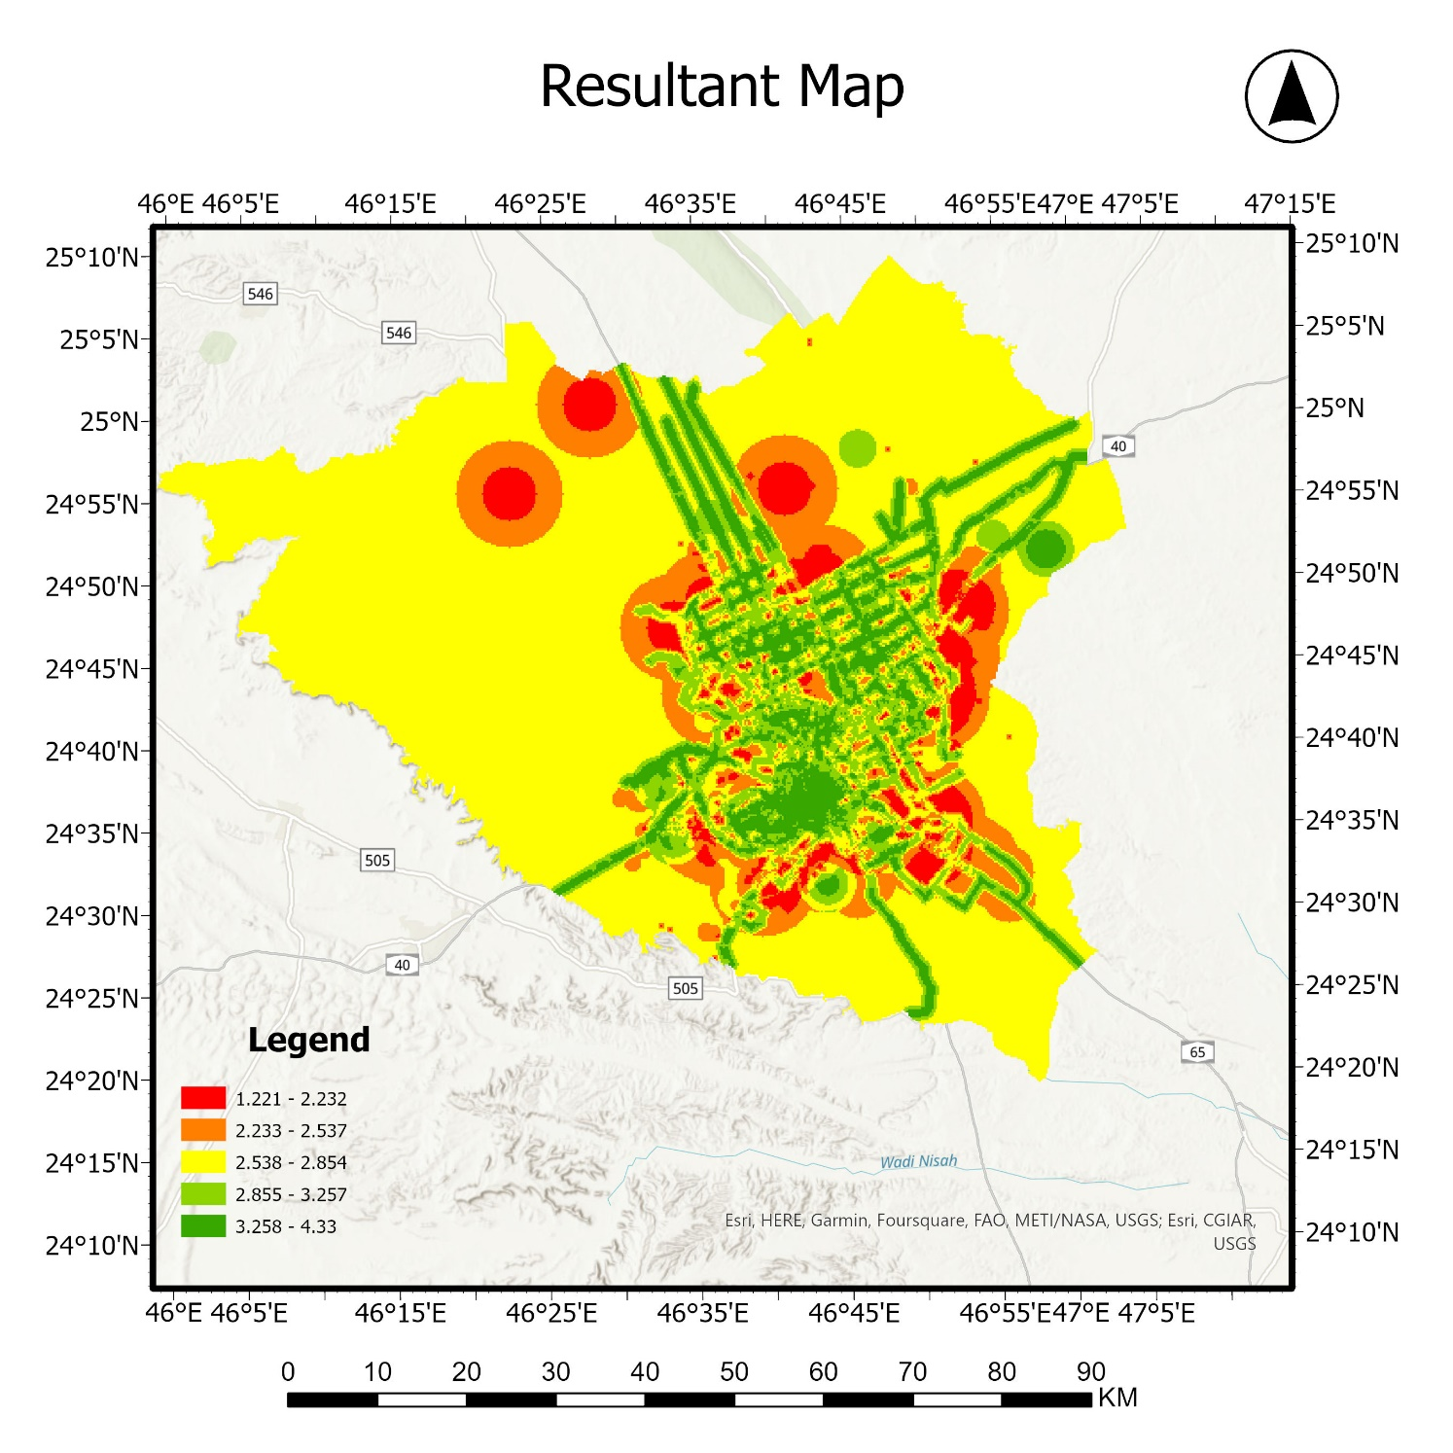
Criteria | Weight
Population | 0.35
Roads | 0.22
Schools | 0.07
Gas Stations | 0.11
Hospitals | 0.18
Factories | 0.06
Figure 13. Shows the resultant map, after applying spatial analysis tools.

Slide 20
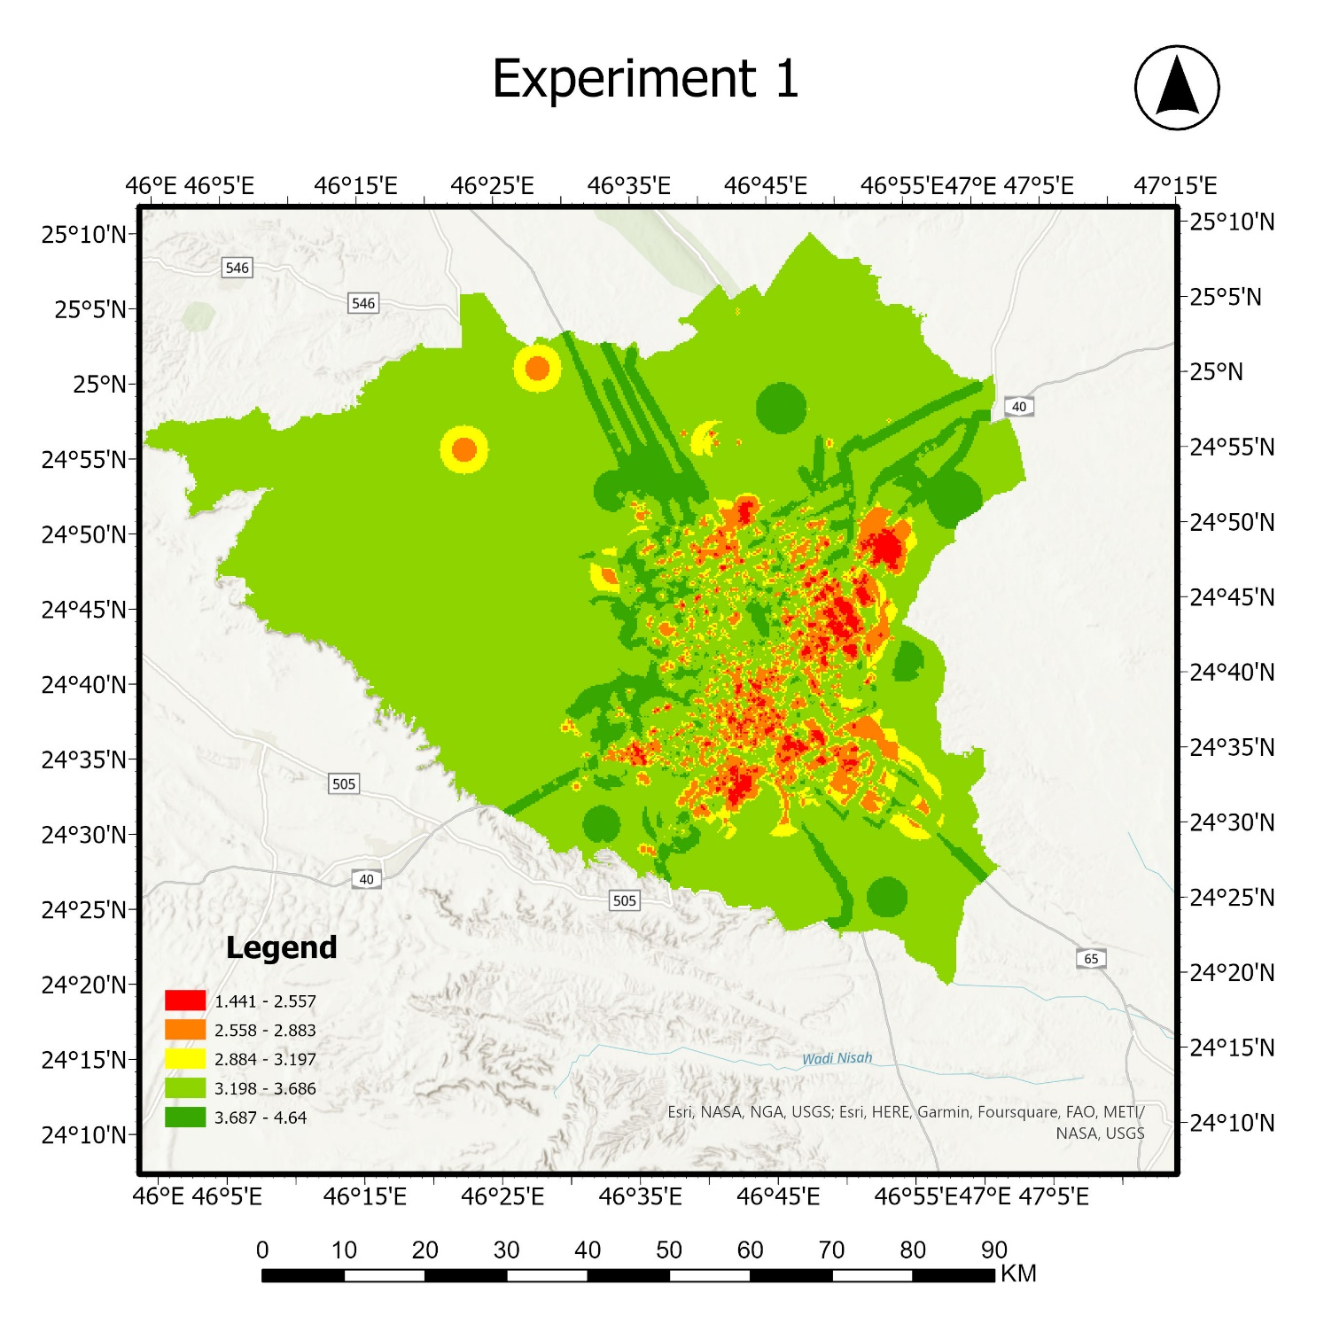
Criteria | Weight
Population | 0.1667
Roads | 0.1667
Schools | 0.1667
Gas Stations | 0.1667
Hospitals | 0.1667
Factories | 0.1667
Figure 15. Shows the resultant map, after applying spatial analysis tools. (Equal weight criteria)

Slide 21
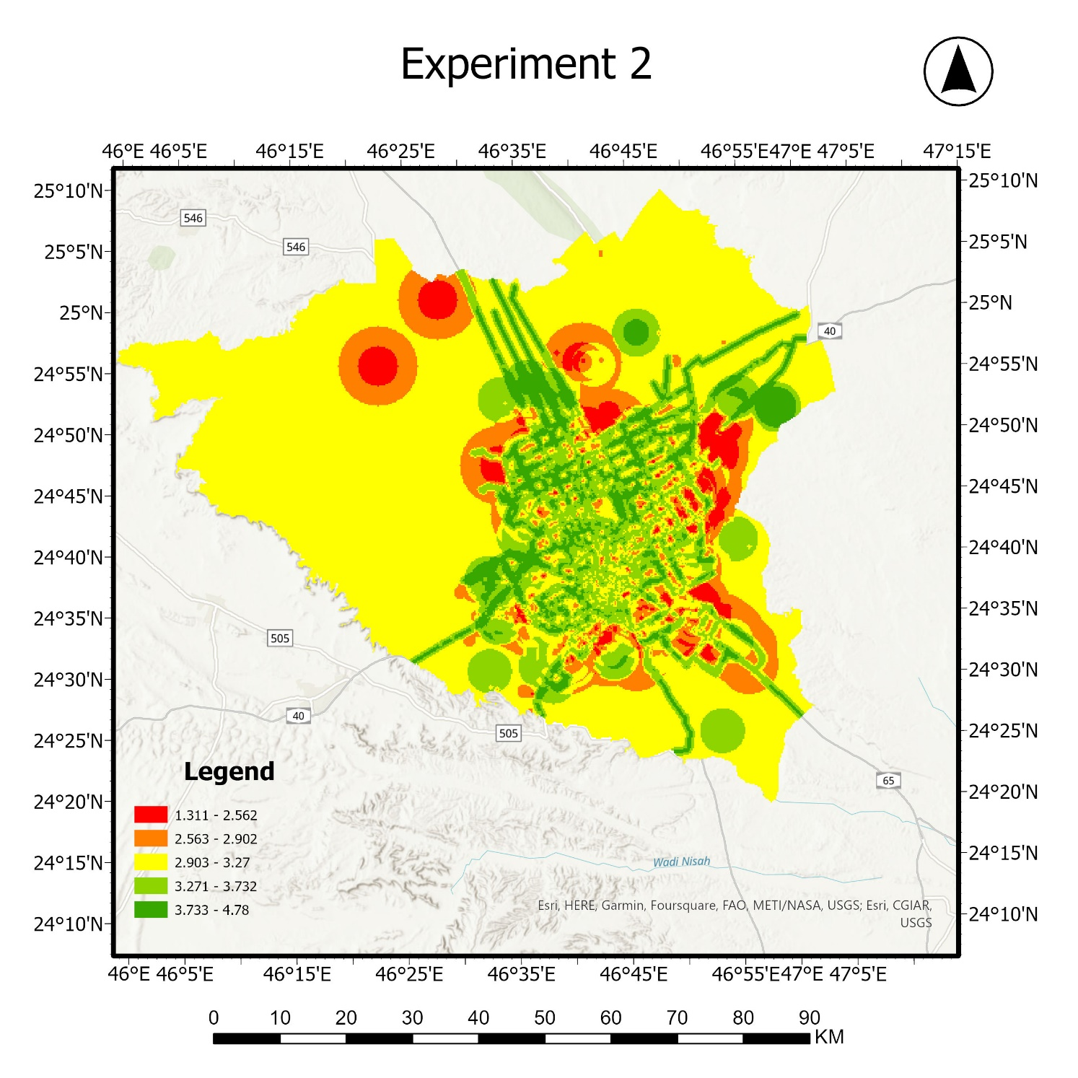
Criteria | Weight
Population | 0.23
Roads | 0.21
Schools | 0.12
Gas Stations | 0.10
Hospitals | 0.19
Factories | 0.15
Figure 16. Shows the resultant map, after applying spatial analysis tools.

Slide 22
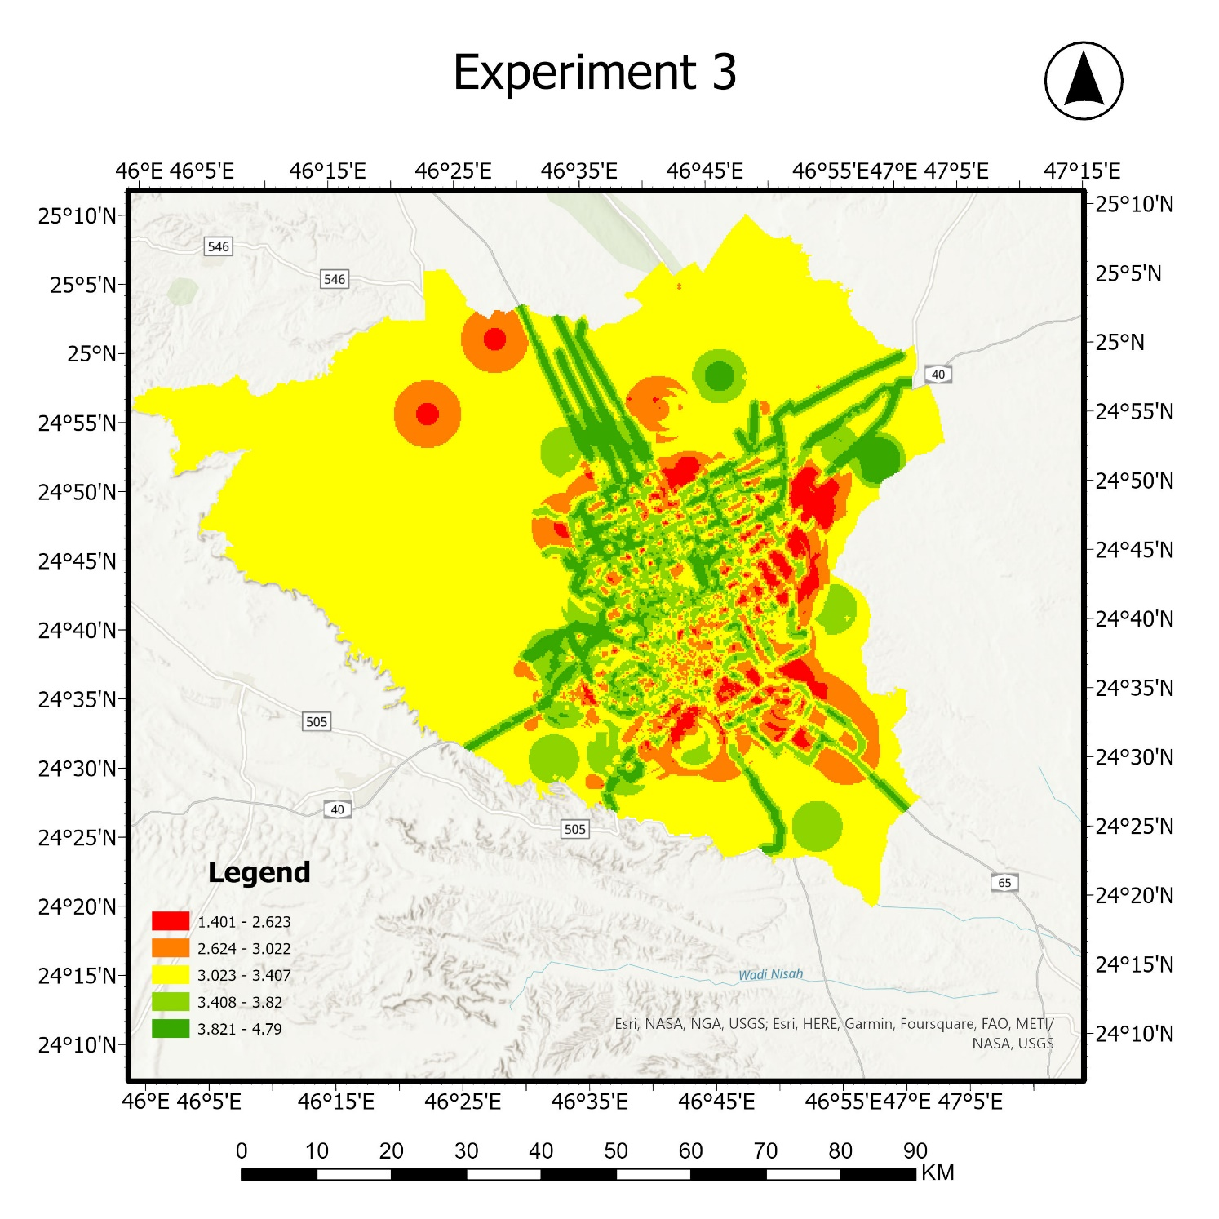
Criteria | Weight
Population | 0.23
Roads | 0.21
Schools | 0.12
Gas Stations | 0.10
Hospitals | 0.19
Factories | 0.15
Figure 17. Shows the resultant map, after applying spatial analysis tools.

Slide 23
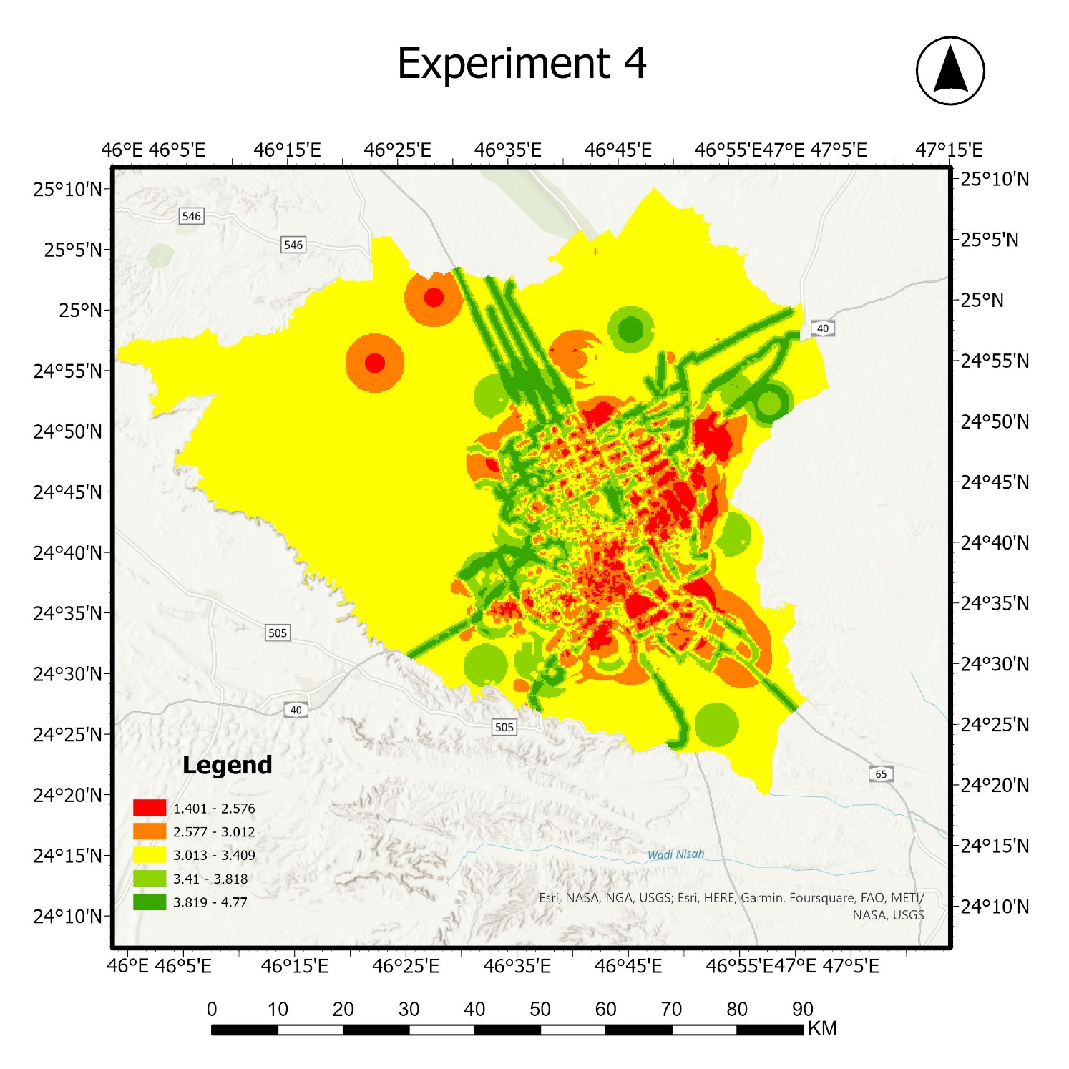
Criteria | Weight
Population | 0.23
Roads | 0.21
Schools | 0.12
Gas Stations | 0.10
Hospitals | 0.19
Factories | 0.15
Figure 19. Shows the resultant map, after applying spatial analysis tools.

Slide 24
We conclude that, experiment 2 is the best and choose it as our map
Criteria | Weight
Population | 0.23
Roads | 0.21
Schools | 0.12
Gas Stations | 0.10
Hospitals | 0.19
Factories | 0.15
Figure 20. Shows the resultant map, after applying spatial analysis tools.

Slide 25
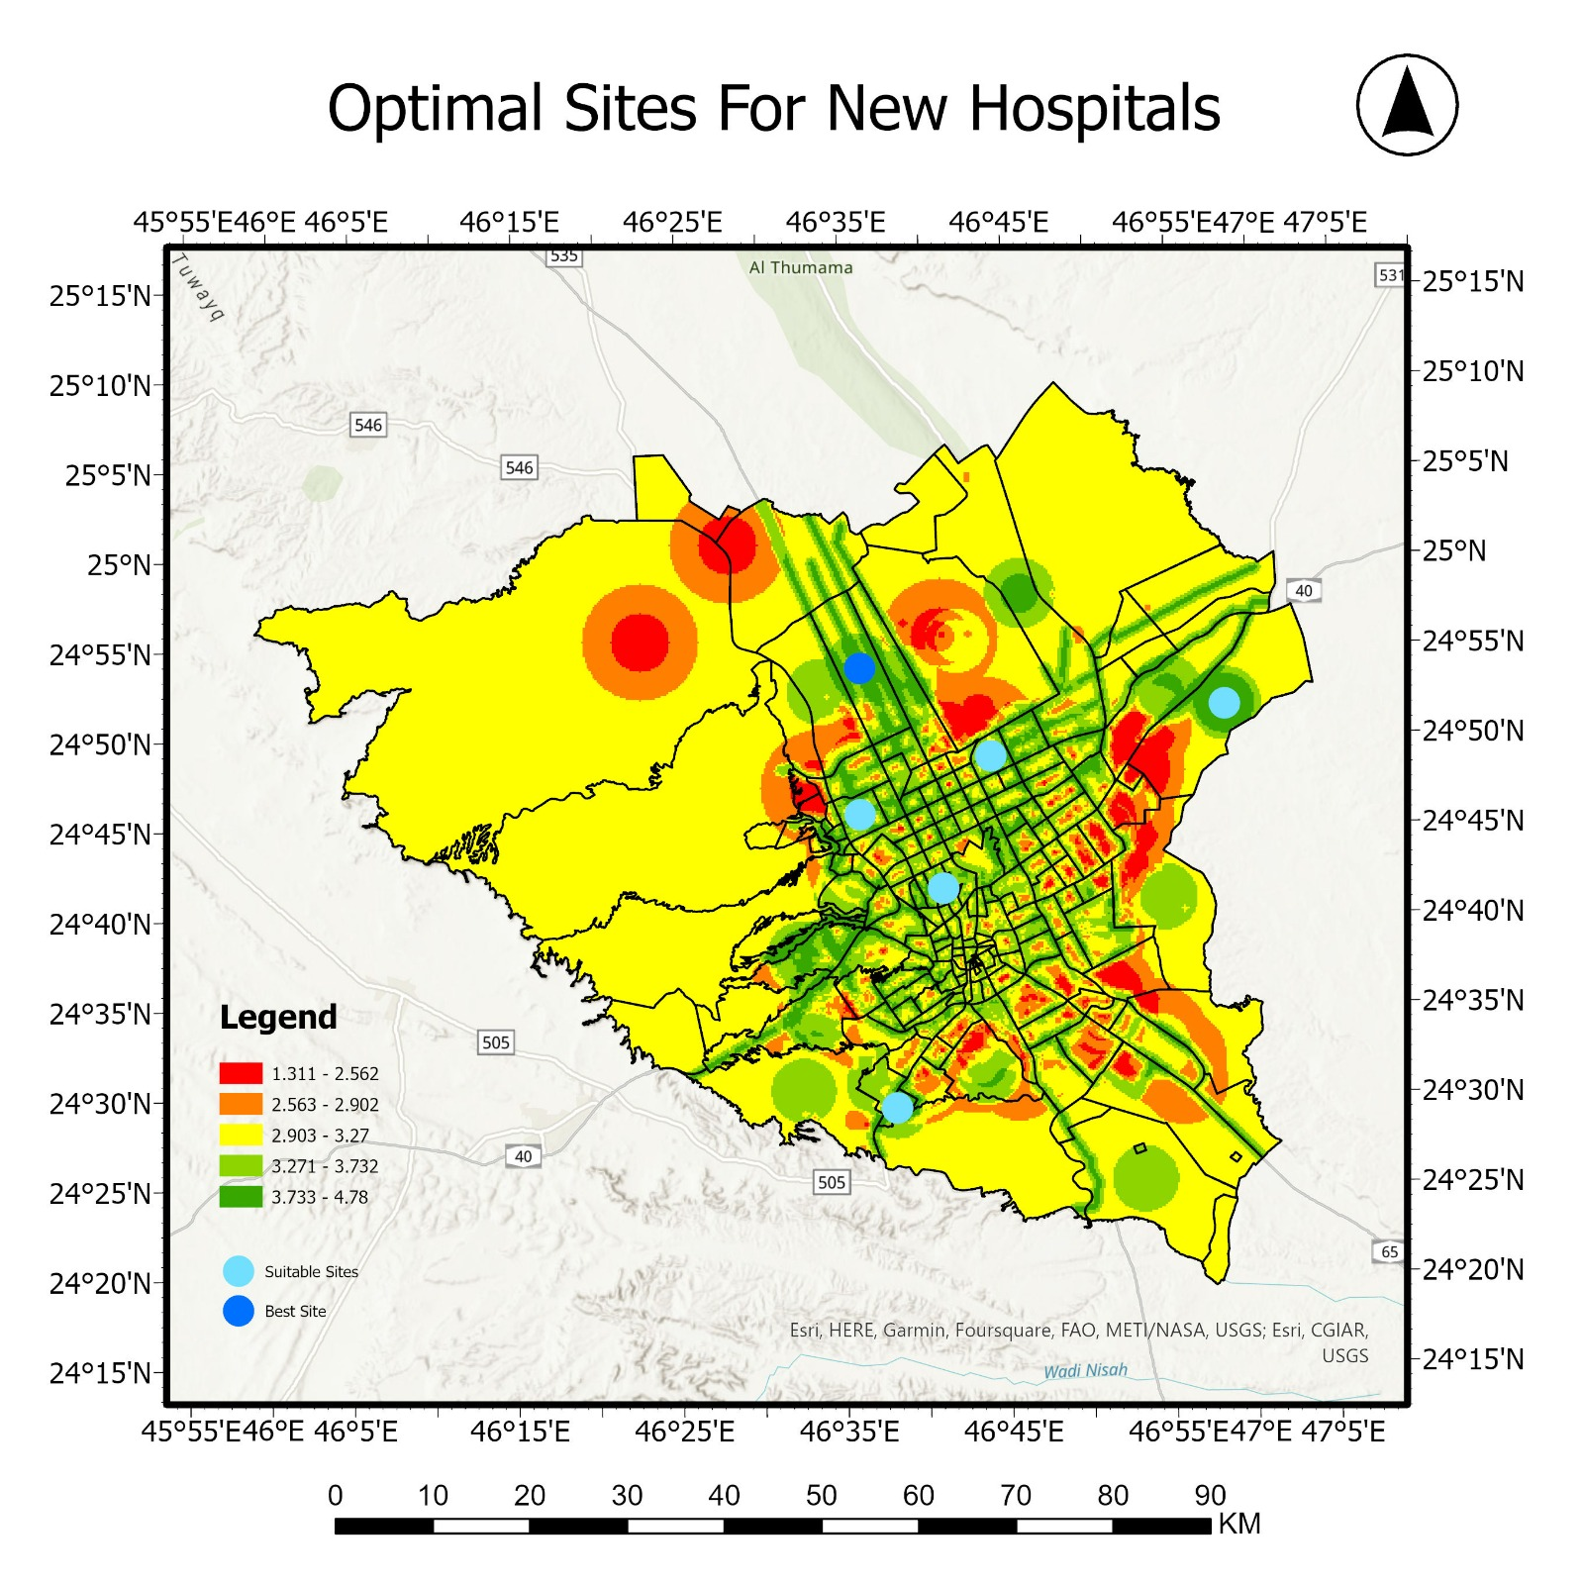
Resultant map
The resultant map shows, the recommended sites for new hospitals, sites that have a value of more than 4 were selected, the optimal site which has the highest value, lies in Al-Aarid neighbourhood while the other sites lie in : Alnadheem , Olaya , Ohod , Hittin and Qortobah.
Figure 21. Shows the resultant map, after applying spatial analysis tools.

Slide 26
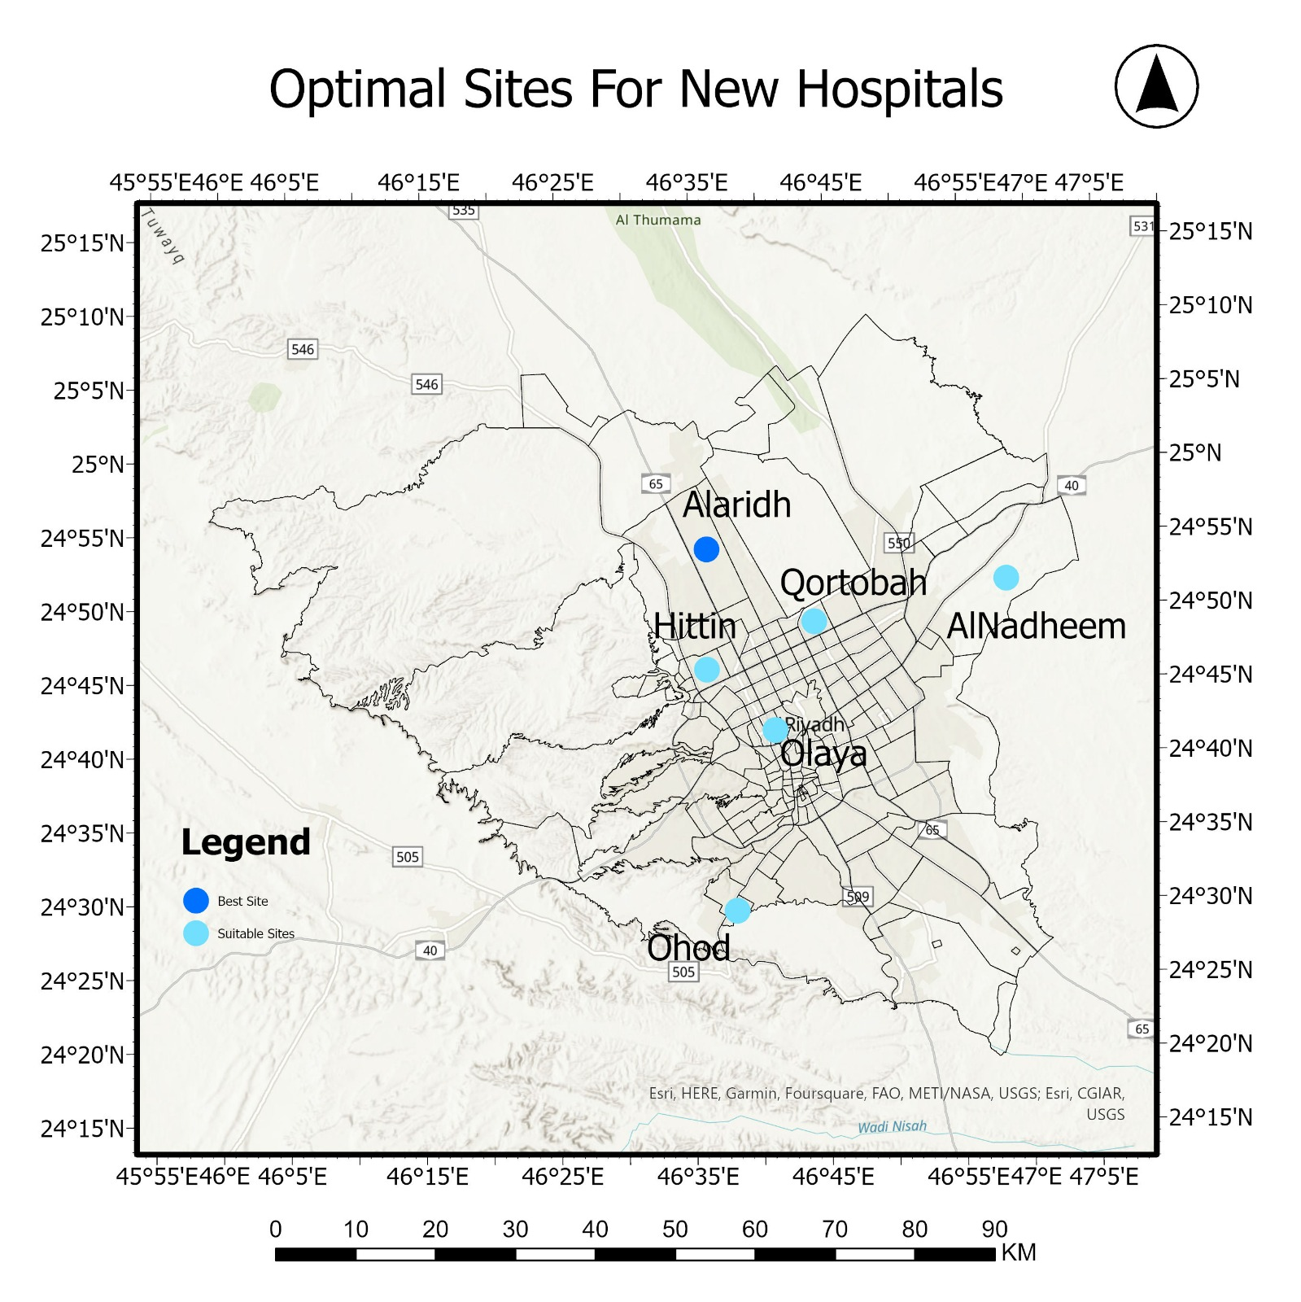
Resultant map
The number of hospitals to be built, can be determined based on the need for beds and ensuring the ideal distribution of these beds.
Figure 22. Shows the resultant map, after applying spatial analysis tools.

Slide 27
Results and Discussion
Table.6 shows the selected sites values from all criteria.
 | Population | D.T. Roads | D. F. hospitals | D. F. Factories | D. F. Schools | D. F. Gas stations | Total
Site 1 | 4 | 5 | 5 | 5 | 5 | 5 | 4.73
Site 2 | 4 | 5 | 3 | 5 | 4 | 5 | 4.23
Site 3 | 5 | 1 | 5 | 5 | 5 | 5 | 4.12
Site 4 | 5 | 5 | 2 | 4 | 3 | 5 | 4.1
Site 5 | 3 | 4 | 4 | 5 | 5 | 5 | 4.04
Site 6 | 5 | 5 | 1 | 5 | 3 | 5 | 4

Slide 28
Optimal Site Results with surrounding criterias:
Population density = 5580 – 21581 Person/${sqkm}^{2}$
Distance to main roads = 0.05 Km
Distance from hospitals = 8.70 Km
Distance from factories = 12.43 Km
Distance from gas stations = 2.31 Km
Distance from schools = 2.63 Km

Slide 29
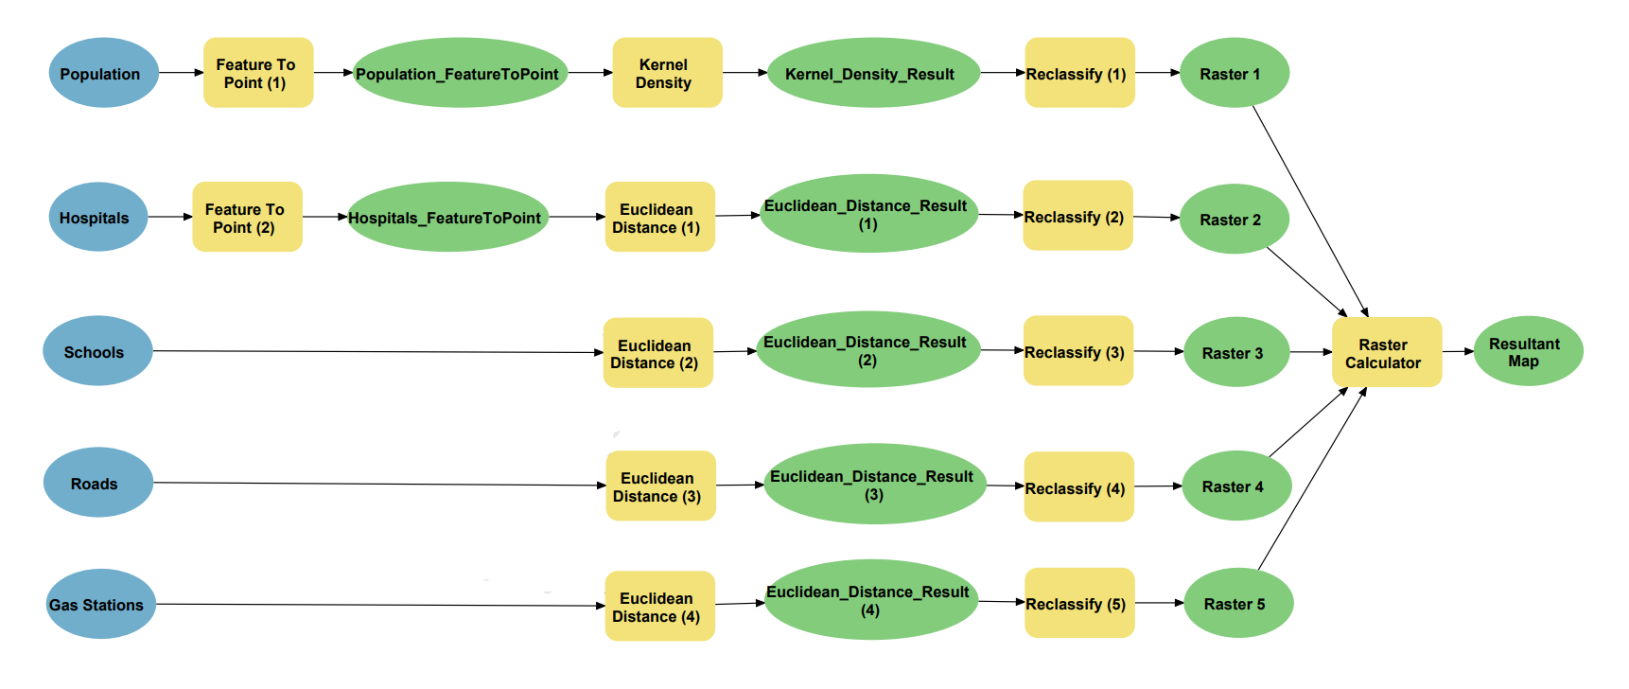
Figure 23. The model-builder shows the used spatial analysis tools for every map

Slide 30
The End

